Slide 1
Inferential Analysis for Heart Disease Prediction Data Note: Associated data: https://d.docs.live.net/66e5ecfe158147c5/Public/Capstone%20Project/Heart_Disease_Prediction_Descriptive_Analysis.xlsx

Slide 2
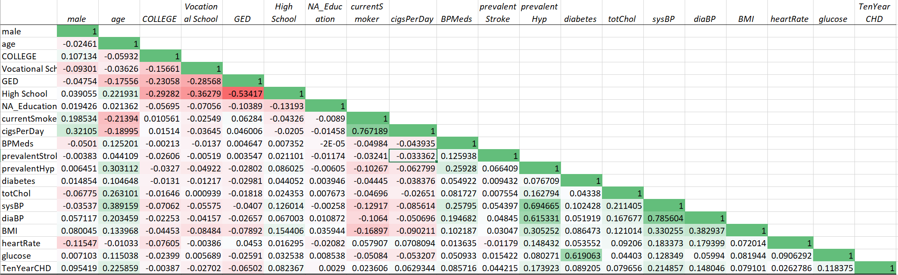
Data was cleaned to remove ’ N/A’s ‘ and Correlation matrix for this data suggests ‘Age’, ’Prevalent Hyp’, ‘Systolic BP’, ‘Diastolic Bp’ and ‘Glucose’ more correlated to having a chronic heart disease in last 10 years compared to other attributes.

Slide 3
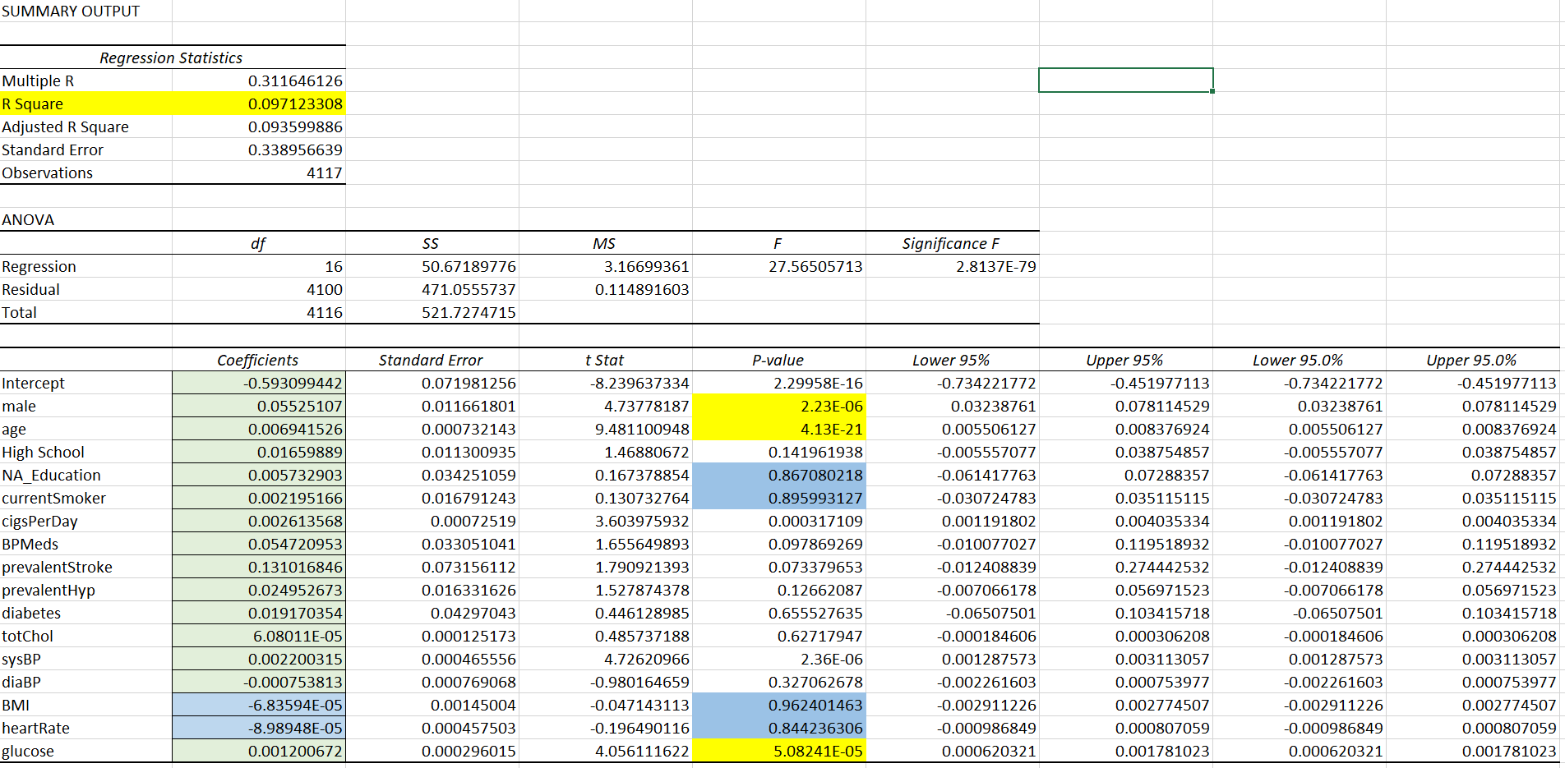
Regression for the same data gives a R Squared value of 0.09712308. The P- Values for BMI and HeartRate has a higher P-value and low coefficient correlation suggesting low correlation overall.

Slide 4
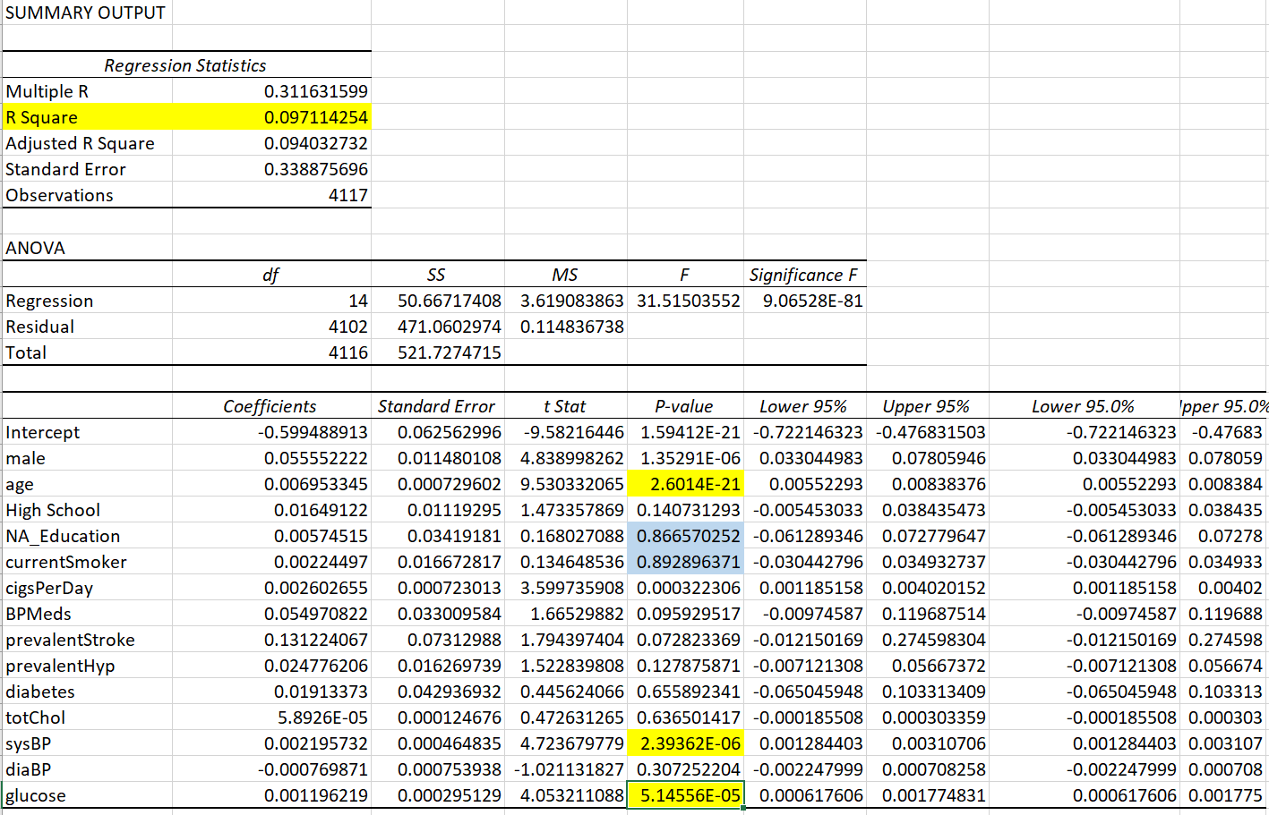
Regression model output for data with BMI and HeartRate data removed showing similar output

Slide 5
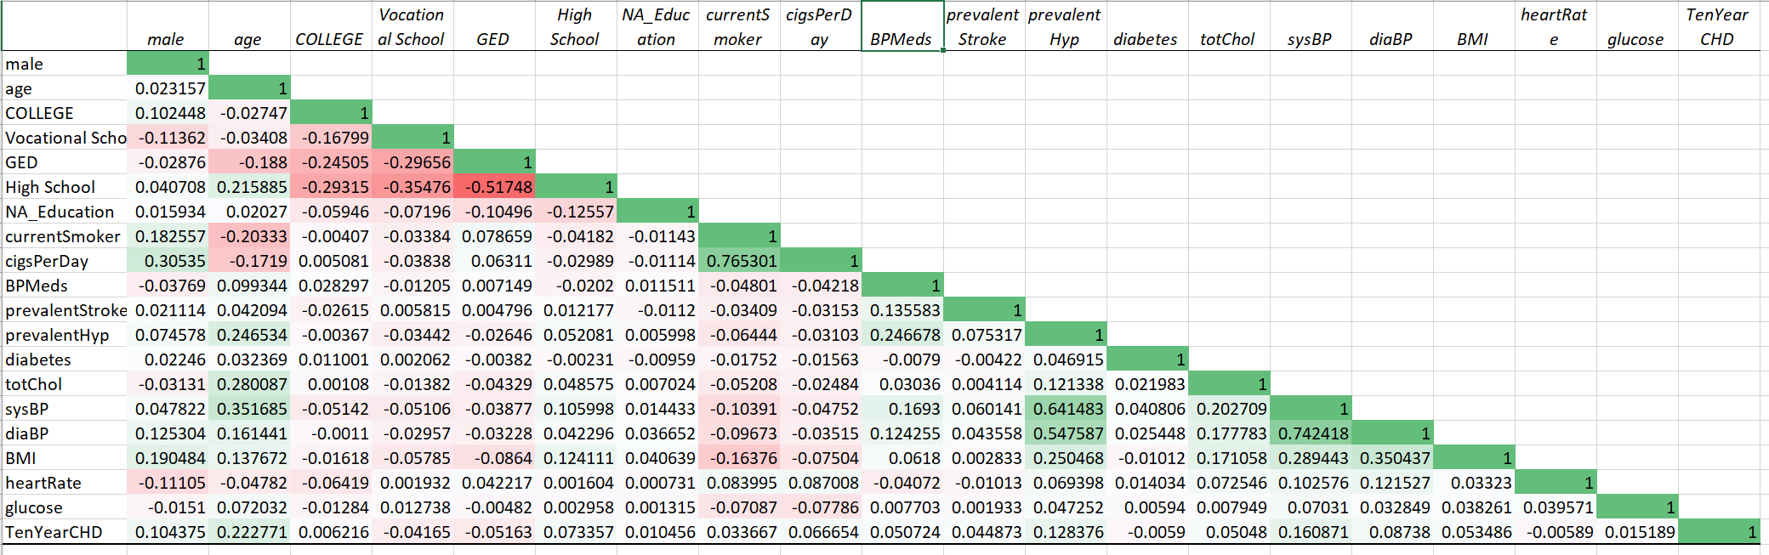
The following matrix was established with outliers and N/A ‘s removed from original data with similar output showing stronger correlation of 4 attributes namely, ‘Age’, ’Prevalent Hyp’, ‘Systolic BP’ and ‘Diastolic Bp’

Slide 6
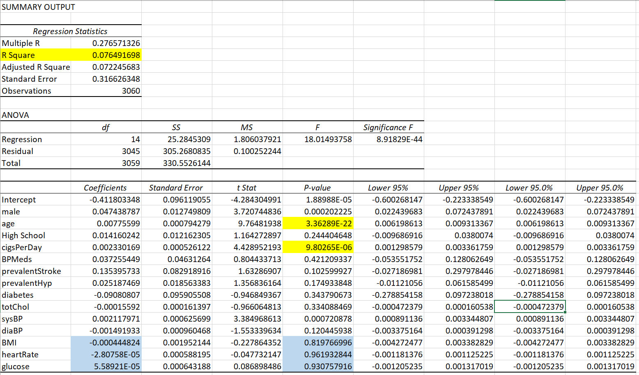
The following regression was established with outliers and N/A ‘s removed from original data with R-Square value of 0.076491698

Slide 7
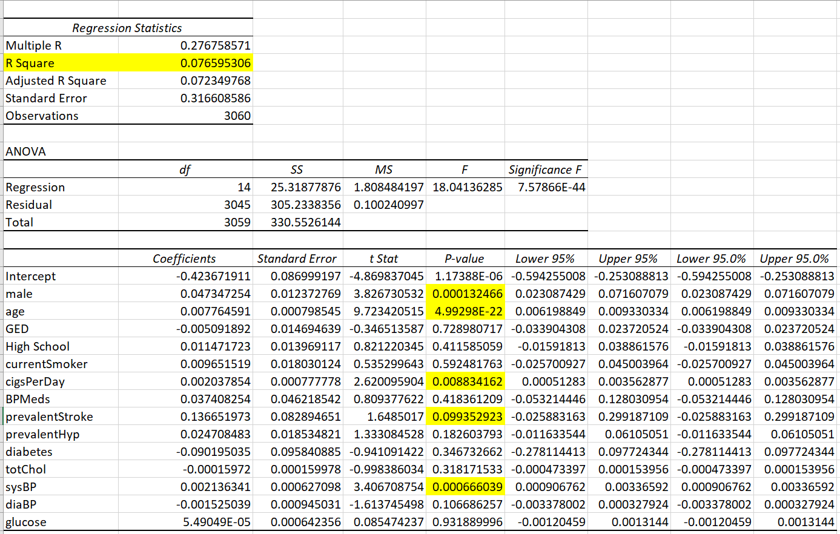
The following regression was established with outliers and N/A ‘s removed from original data and BMI and HeartRate data removed. This output shows lower P- values for ‘Age’ ,’Gender’, Cigsperday’, ‘Prevalent Stroke’

Slide 8
Summary: Inferential statistic analysis of 19 attributes with past 10 year cognitive heart disease occurrence in people suggested very low correlation overall. The p-value for the data with outliers, is found to be 0.09712308 as compared to the value of 0.076491698 for data with outliers removed Out of all the 19 attributes , the following attributes are found to have negative correlation: GED Diabetes Total Cholesterol Diastolic BP

